Slide 1
2- Installing Python

Slide 2
context
Python.org 3
Download 4
Installation 5
Verify installation in cmd 6

Slide 3
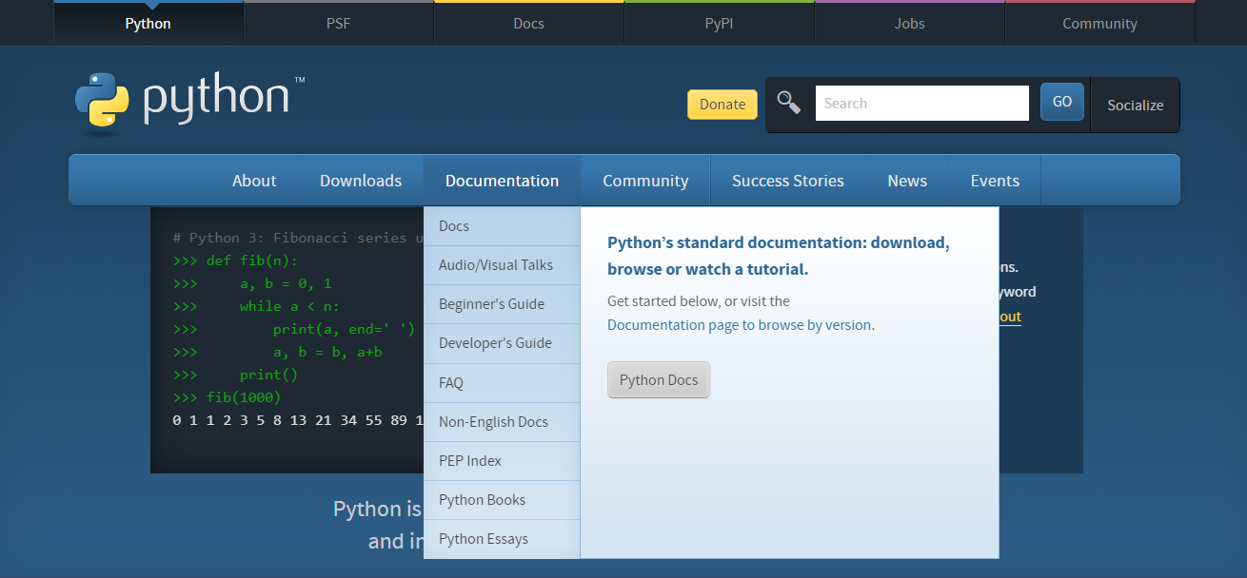
Python.org

Slide 4
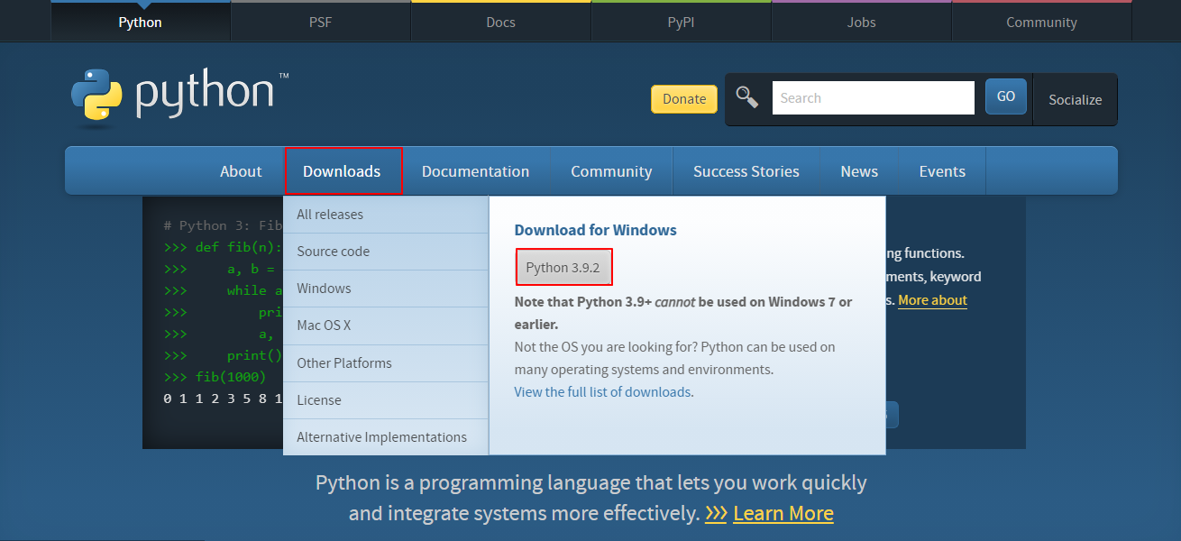
Download

Slide 5
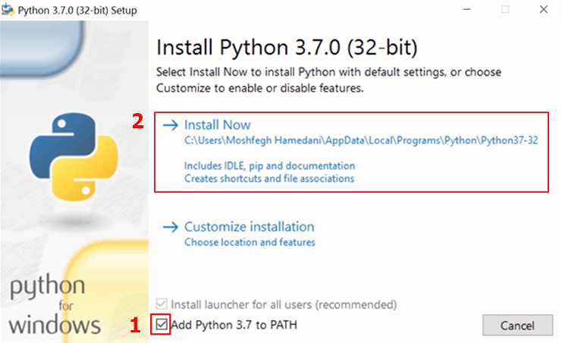
installation

Slide 6
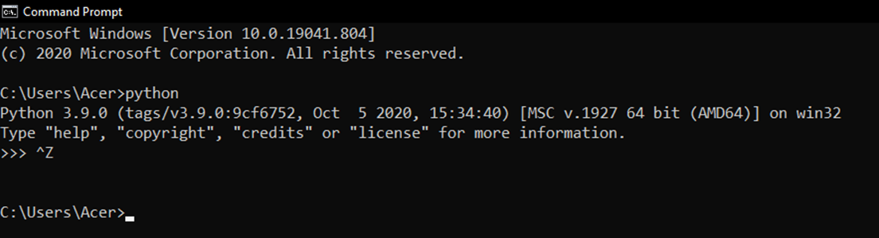
Verify that we have installed python properly
Open cmd,
Type: Python
To exit press ctr+z and then enter

